Slide 1

Murder Accountability Project
www.murderdata.org
Thomas Hargrove
hargrove@murderdata.org
571-606-5999

Slide 2
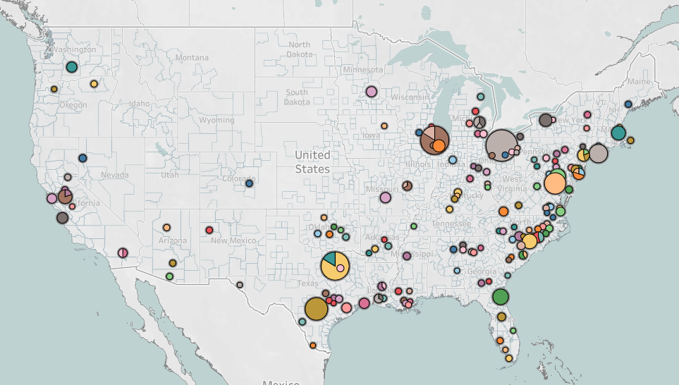
MAP’s Serial Algorithm

Slide 3
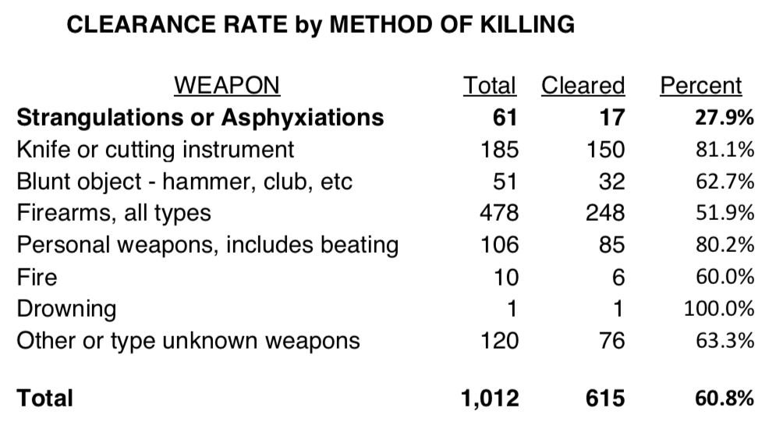
What the Algorithm Found

Slide 4
Serial Aspects
Overwhelmingly (94%), victims recovered out-of-doors or in abandoned buildings
At least three-quarters of homicides had clear sexual components: clothing removed or ripped to show female form; signs of recent sexual activity
Victims disproportionately had histories of sex work, illicit drug use, or both. Serial killers have an historically recognized preference for these victims.

Slide 5
Other Serial Aspects
Some cases seem serial “on their face.” 2007, in 24 hour period, Theresa Bunn and Hazel Marion Lewis, were found in opposite corners of Washington Park, in burning trash receptacles.
Body recovery sites are similar: 14 in alleys, 9 in abandoned buildings, 8 in vacant lots, 7 in trash receptacles.
Recovery sites in three broad areas: South Side (largest), West Side, and extreme South Side. Linear aspect to South Side killings.

Slide 6
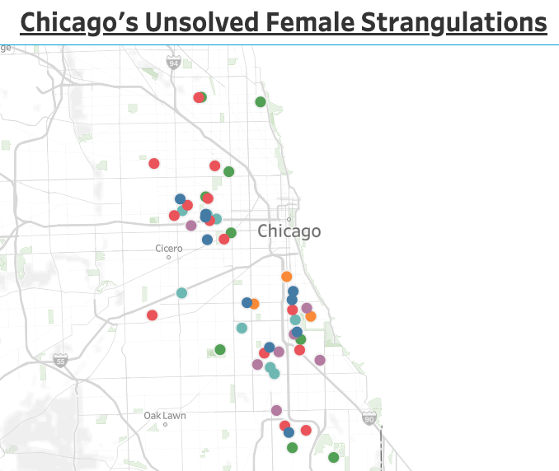
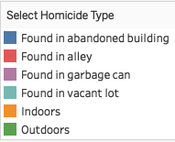

Slide 7
MAP Recommendations
Wholeheartedly endorse recent actions by Superintendent Eddie Johnson, who ordered case review to attempt “additional testing” of evidence.
Murder books from 50+ cases should be assembled in one location. Review should assume cases are linked and look for commonalities.
Methodical review of DNA samples. All samples, not just swabs from vaginal vault, should be sent to lab(s) for expedited testing – skin from under victims’ fingernails should be tested quickly.

Slide 8
Other Recommendations
Strongly encourage attempting familial DNA matches using open source databases. This window is closing! Trained volunteers are available.
In consultation with FBI, consider new techniques to pull DNA from difficult materials and surfaces. Consider M-Vac and other technologies.
Aggressive review of CODIS hits, especially homicides that link to other crimes like sexual assaults. Other police departments have made errors in following up on CODIS data.

Slide 9
Other Recommendations
Experience teaches killers probably already known to police. Look for survivors (almost every large series had them) who can provide descriptions.
Since most victims were sex workers, identify pimps and associated prostitutes. Surviving sex workers may have suggestions for likely suspects.
Don’t assume killers had sex with victims. Many serial killers are sexually dysfunctional.

Slide 10
Finally: A Warning
Killer or killers are targeting sex workers and women with history of illegal drug addition (or both). These women should take precautions.
Victims have been 76% African American
and 24% Anglo or Hispanic White.
Victim age range is large and skews toward high middle age. Youngest 18, oldest 58. Median age has increased over time: 35 among oldest killings, 38.5 among most recent.

Slide 11
Murder Accountability Project
www.murderdata.org
Thomas Hargrove
hargrove@murderdata.org
571-606-5999

